Slide 1

AUTISM SPECTRUM DISORDER
ISDS 574 – DATA MINING FOR BUSINESS APPLICATIONS
Vamsi Tanneru
Melissa Soriano Ballesteros
Sai Surya Varun Bade
Madhusudhan Naga Kumar Unnava
Vivek Sompalli
Sahithi Peddapalli

Slide 2

OBJECTIVES
01
02
03
04
05
06
BACKGROUND
VARIABLE
OBSERVATION
DATA CLEANING AND PREPROCESSING
METHOD IMPLEMENTATION
DISCUSSION
LIMITATIONS AND FUTURE WORK

Slide 3
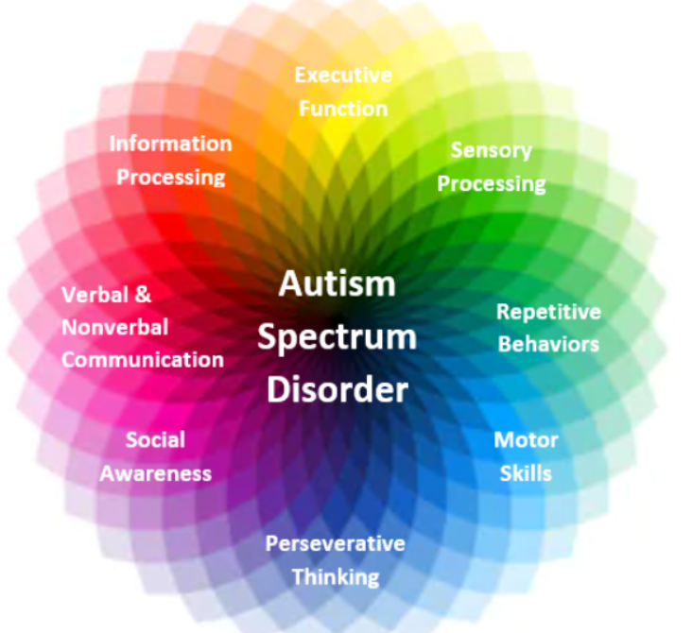
BACKGROUND
Autism, also known as Autism Spectrum Disorder (ASD), is a group of developmental disorders that affect communication, behavior, and social skills.
Causes and Challenges
Autism is a disorder that is primarily influenced by a combination of genetic and environmental factors. Since autism is a spectrum disorder, each person with autism has a unique set of strengths and challenges. People with autism can possess highly developed skills or face significant difficulties in learning, thinking, and problem-solving. Research shows that high-quality early intervention can enhance learning, communication, and social skills and promote healthy brain development. However, the diagnostic process for autism can take several years.

Slide 4
VARIABLES IN THE DATA SET
ID: Unique identifier for each individual in the dataset.
A1_Score to A10_Score: Survey responses to ten questions (A1 to A10) related to autism screening. Each question likely assesses different aspects of behavior or symptoms associated with autism.
Age: Age of the individual.
Gender: Gender of the individual (e.g., male, female).
Ethnicity: Ethnicity or racial background of the individual.
Jaundice: Indicates whether the individual had jaundice at birth (yes/no).
Autism: Indicates whether the individual has a family history of autism (yes/no).
Result: Result of the autism screening assessment. This variable might represent the outcome variable used in predictive modeling.
Age_desc: Description of age group (e.g., "18 and more" indicates adults).
Relation: Relationship of the individual to the person completing the survey (e.g., self, healthcare professional).
Class/ASD: Binary variable indicating the presence or absence of autism spectrum disorder (1 = ASD, 0 = non-ASD).

Slide 5

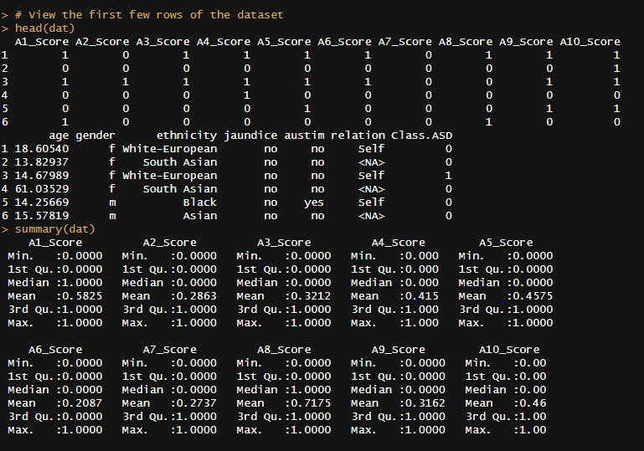
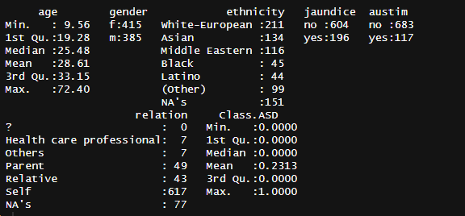
800 ROWS
22 COLUMNS

Slide 6
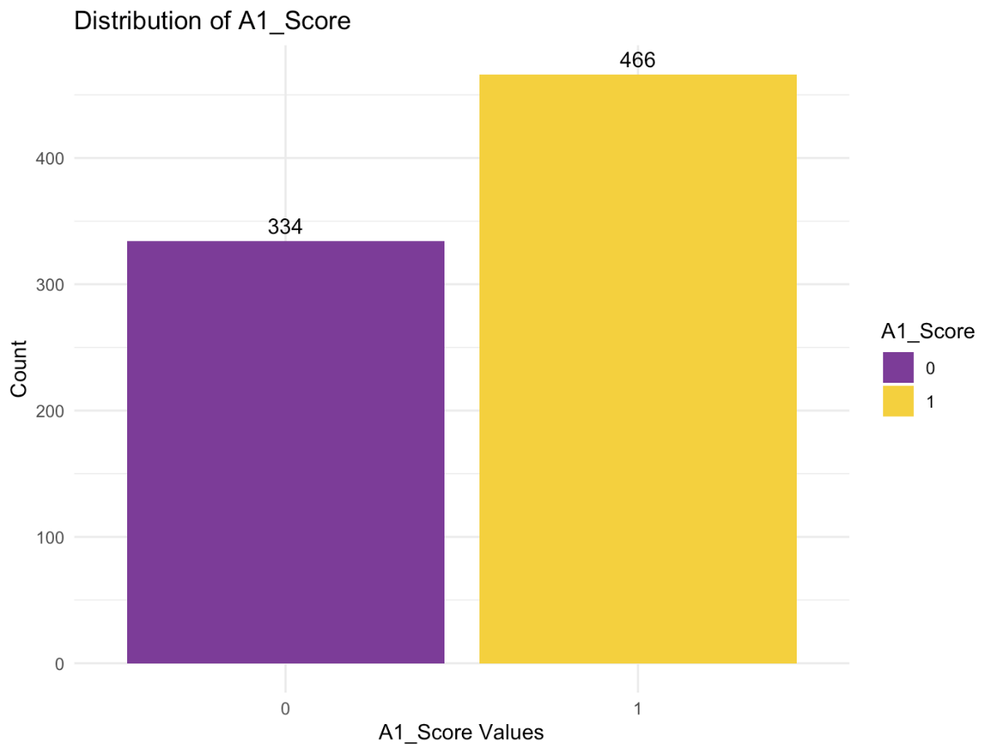
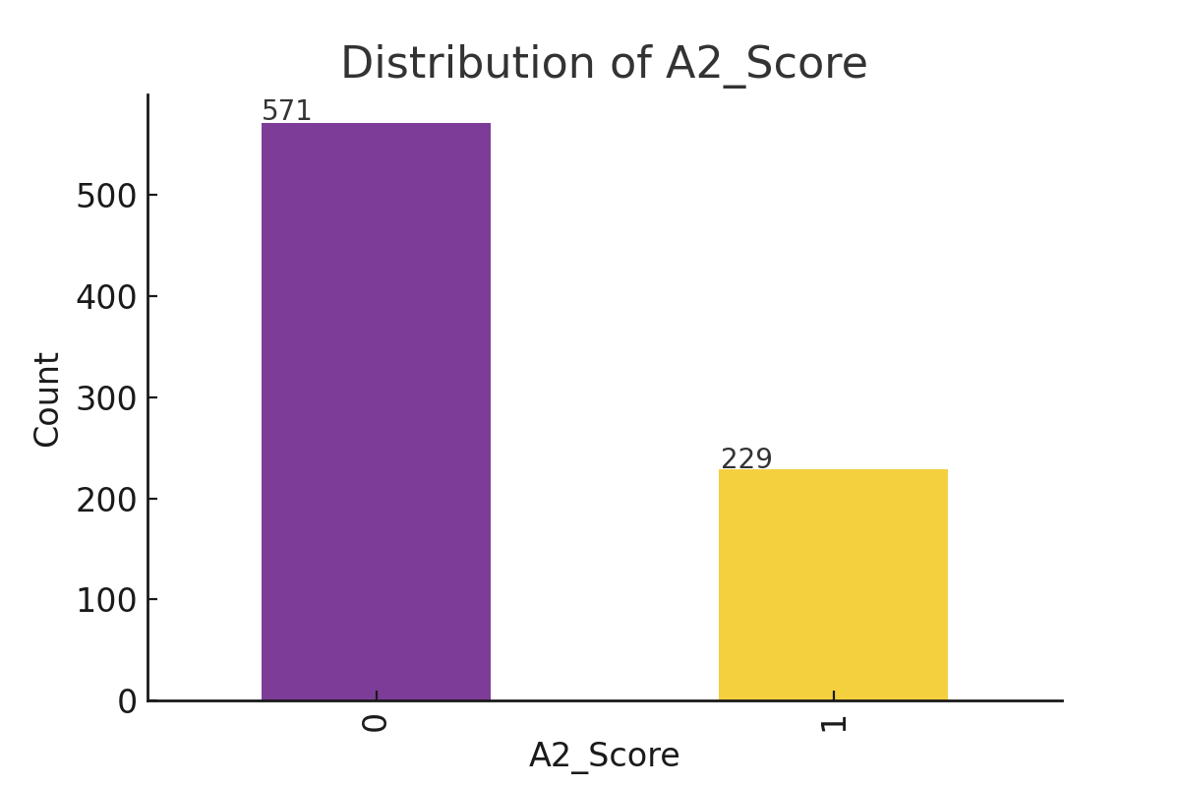
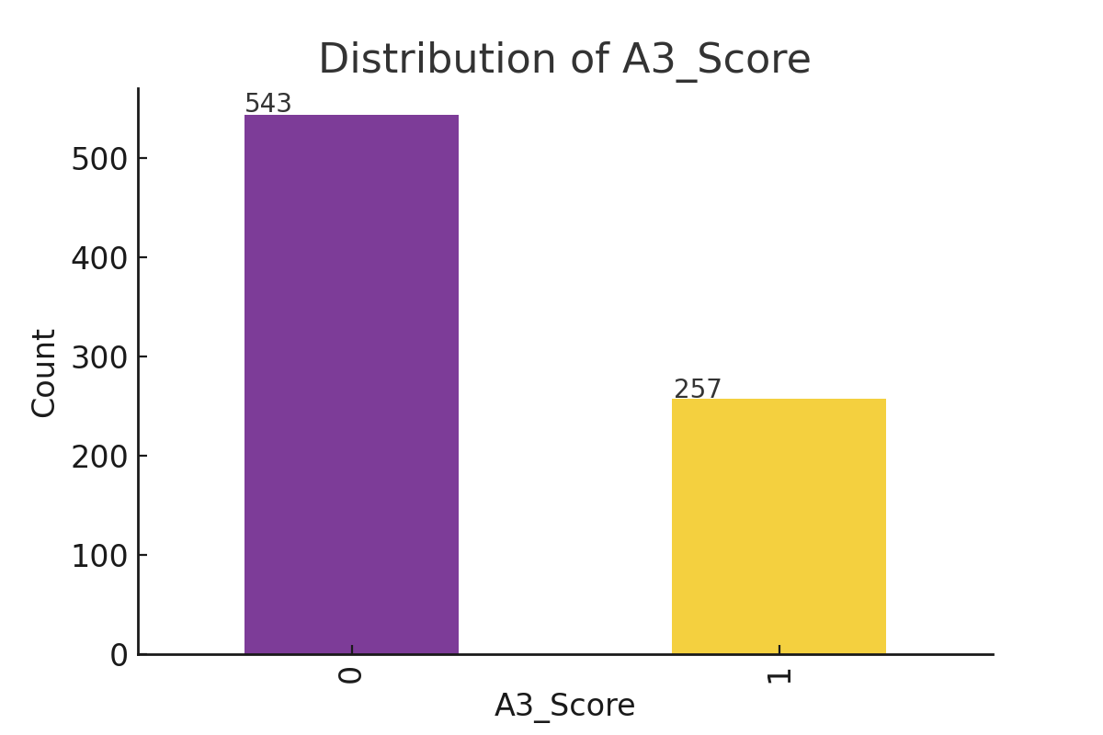
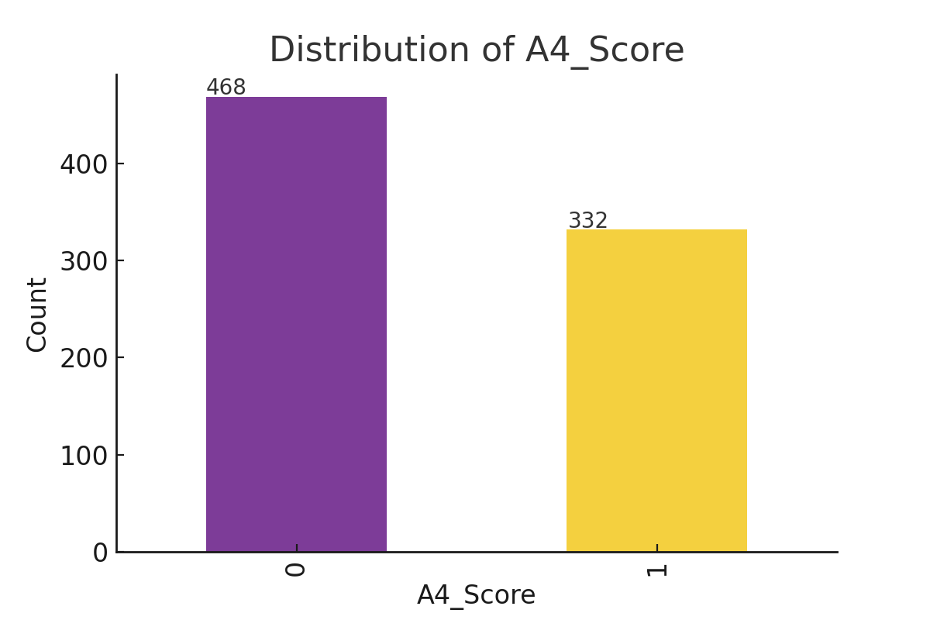
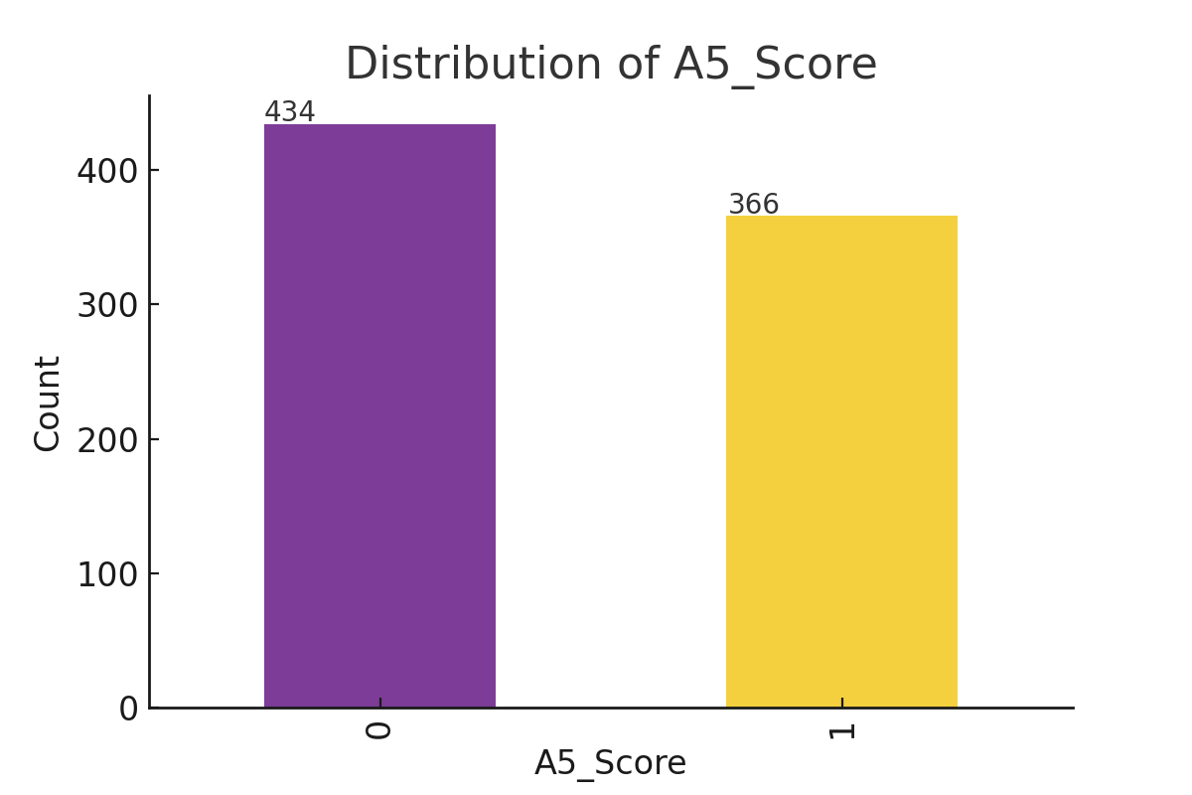
DISTRIBUTION OF VARIABLES
A1_score
To A5_score

Slide 7
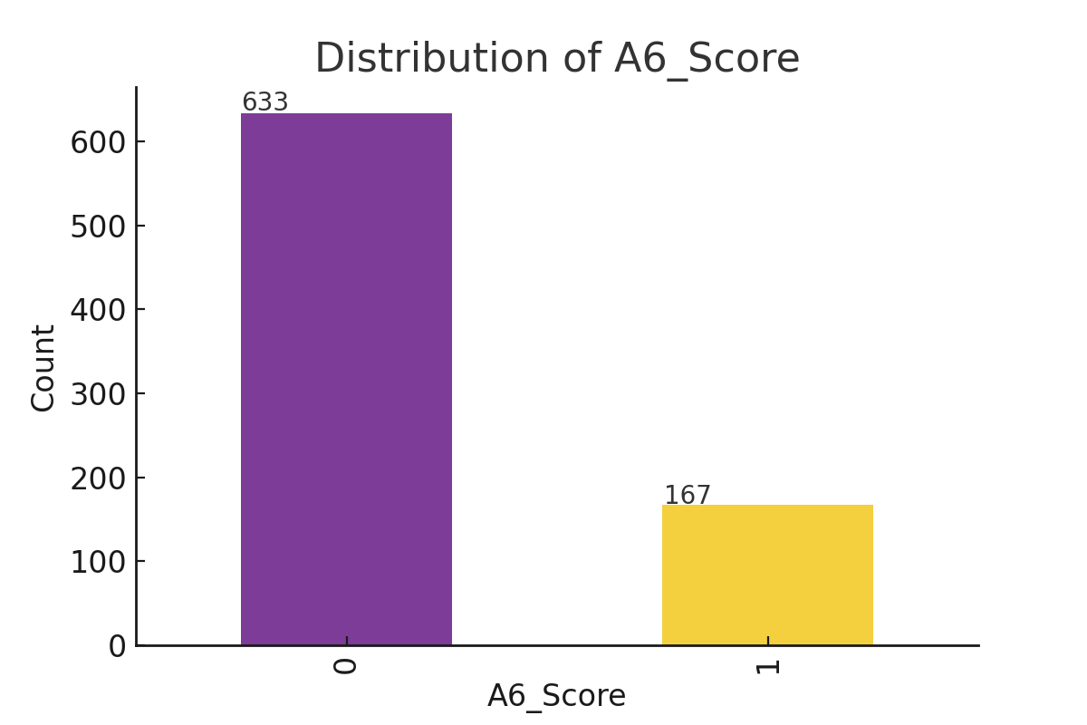

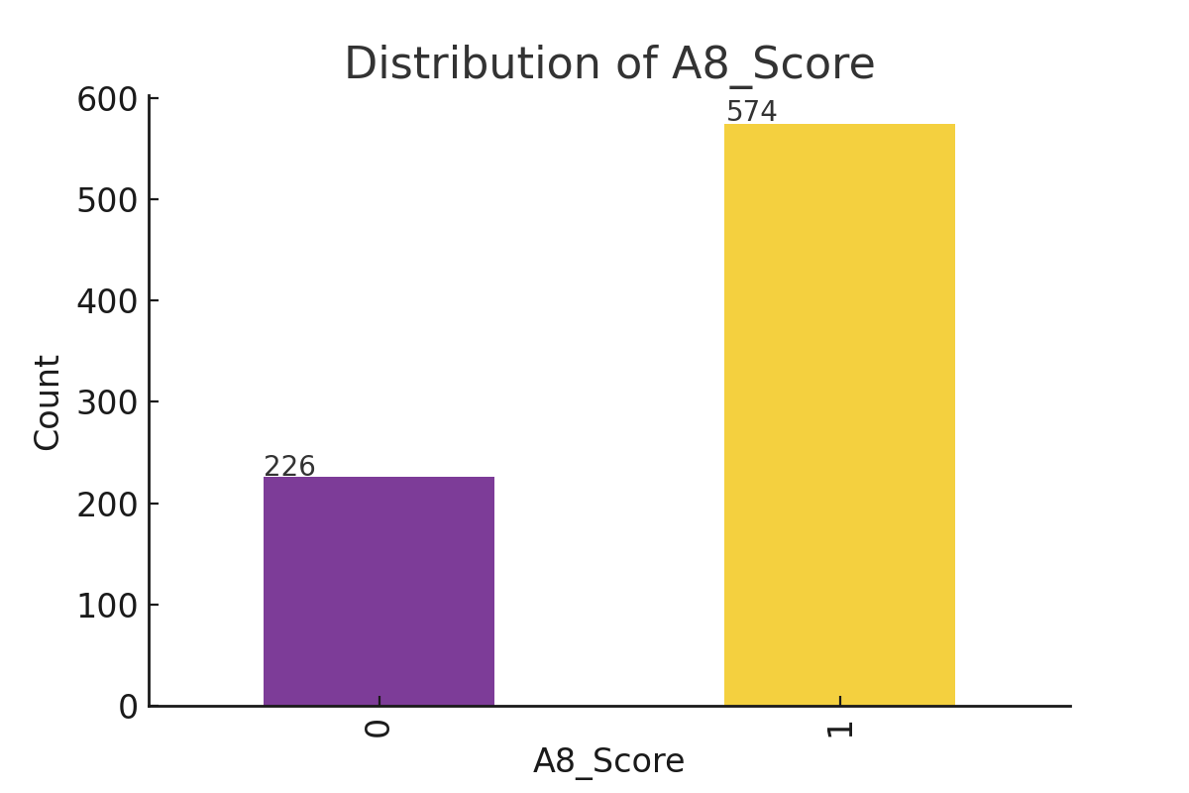


DISTRIBUTION OF VARIABLES
A6_score
To A10_score

Slide 8
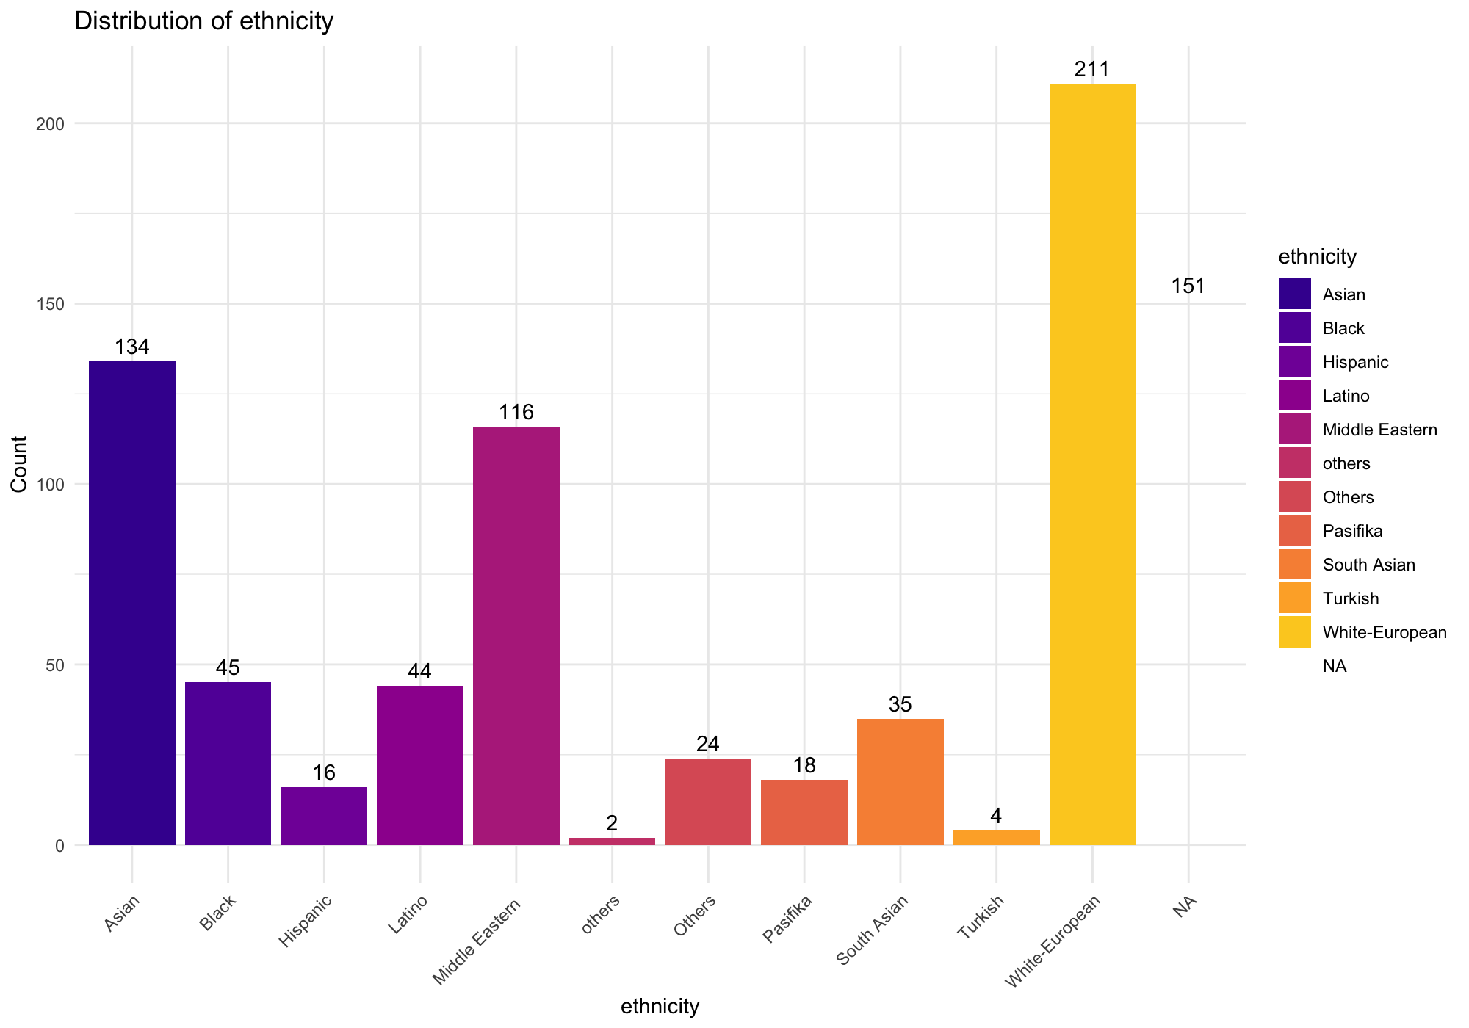
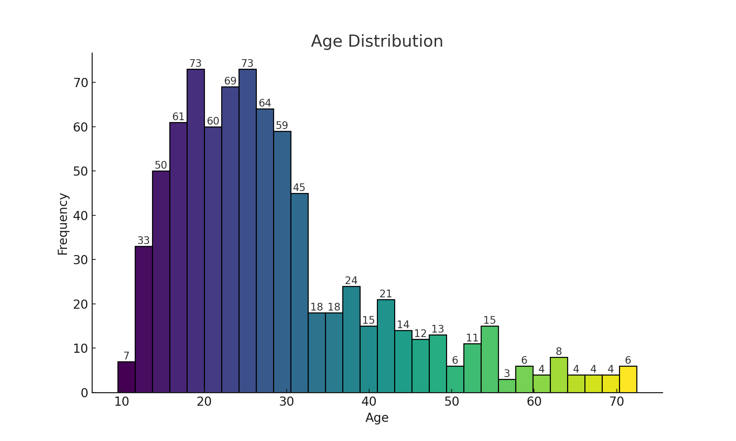
DISTRIBUTION OF VARIABLES
Distribution OF Ethnicity
Distribution Of Age

Slide 9
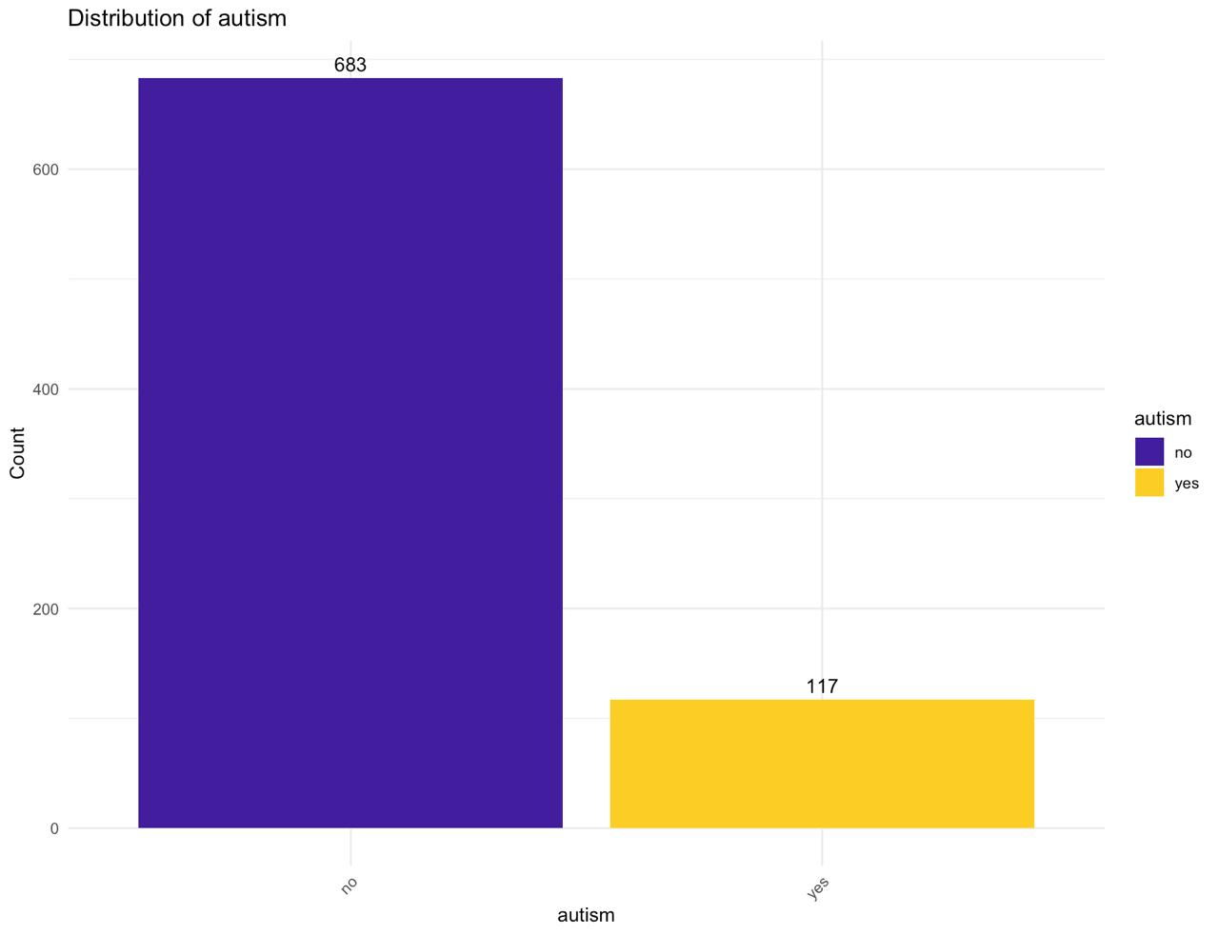
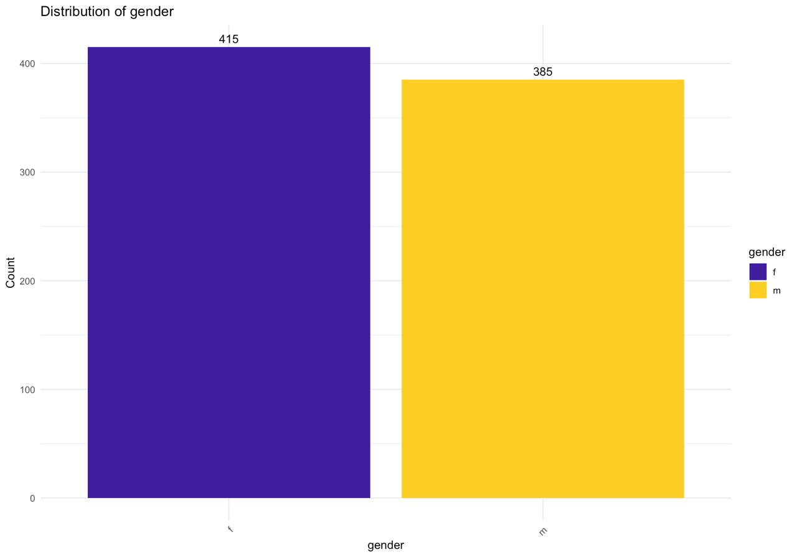
DISTRIBUTION OF VARIABLES
Distribution Of Autism
Distribution Of Gender

Slide 10
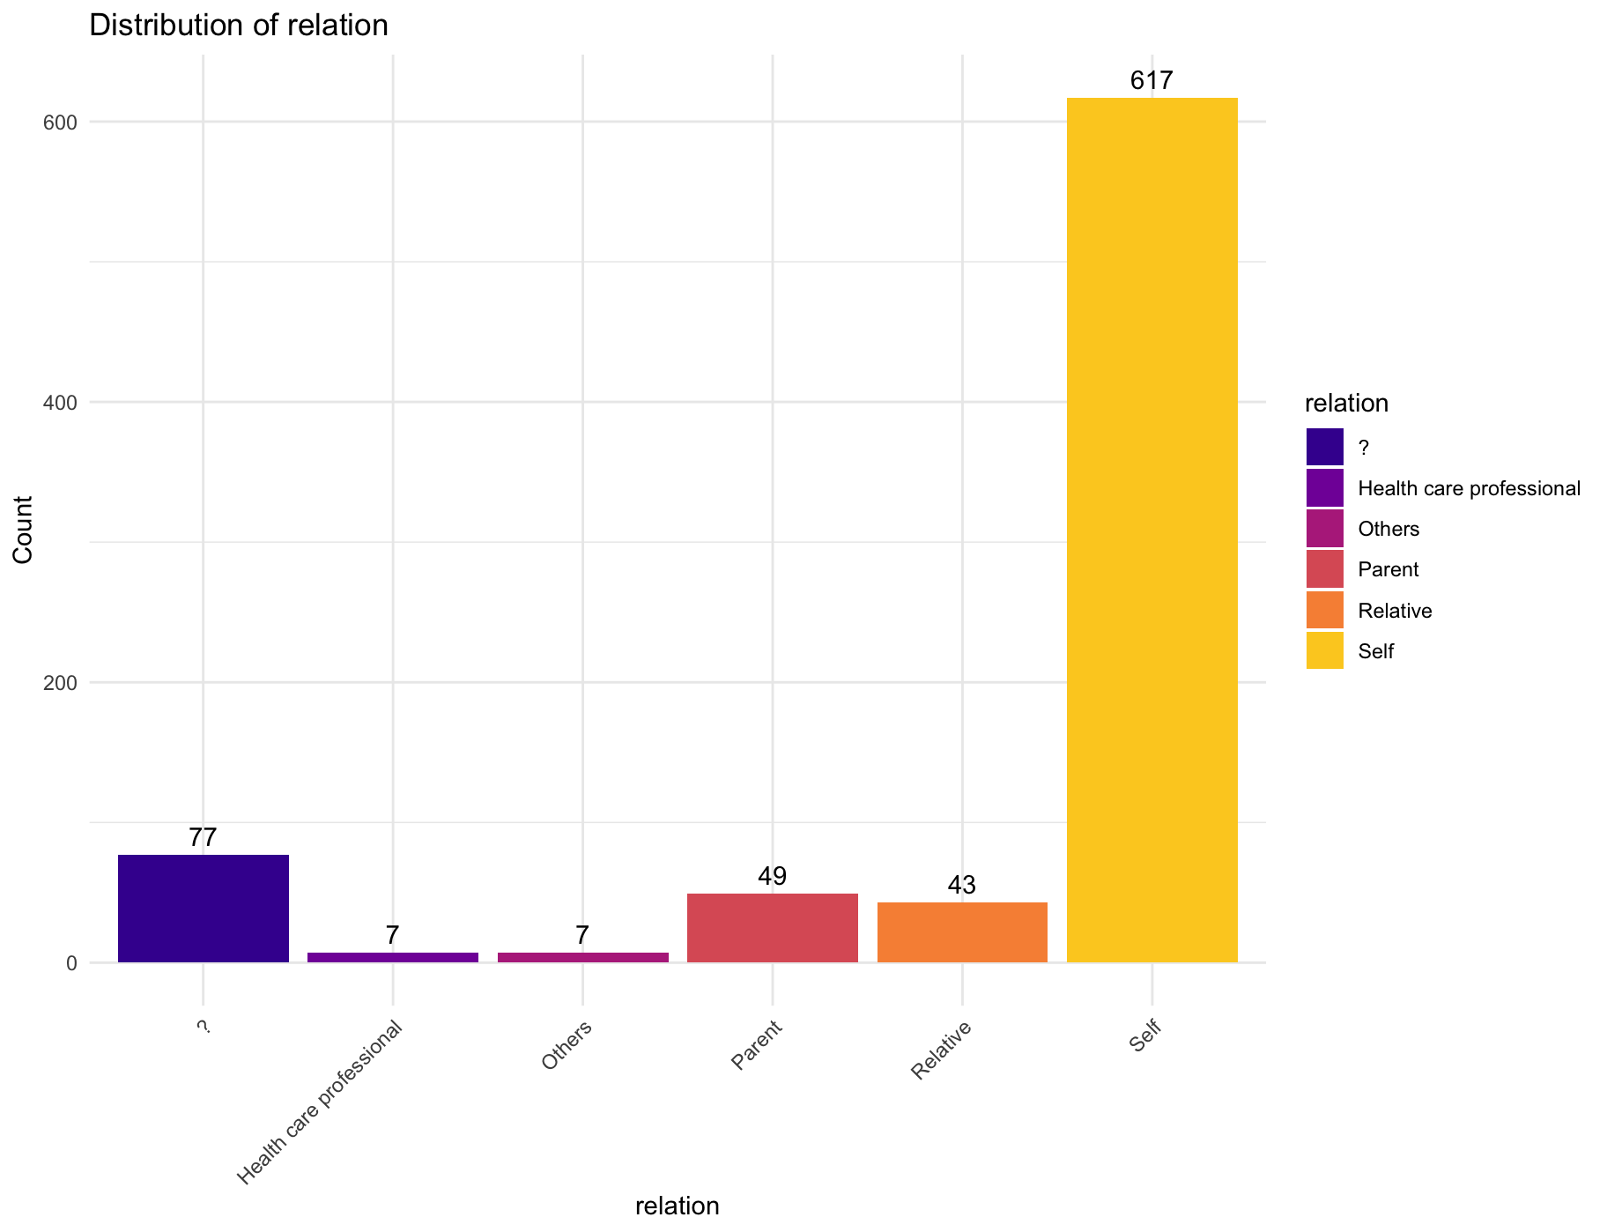
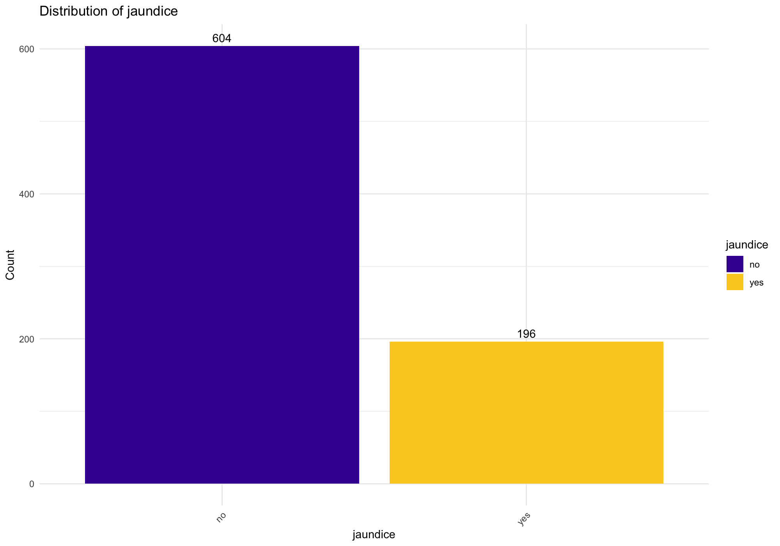
DISTRIBUTION OF VARIABLES
Distribution Of Relationship
Distribution Of Jaundice

Slide 11
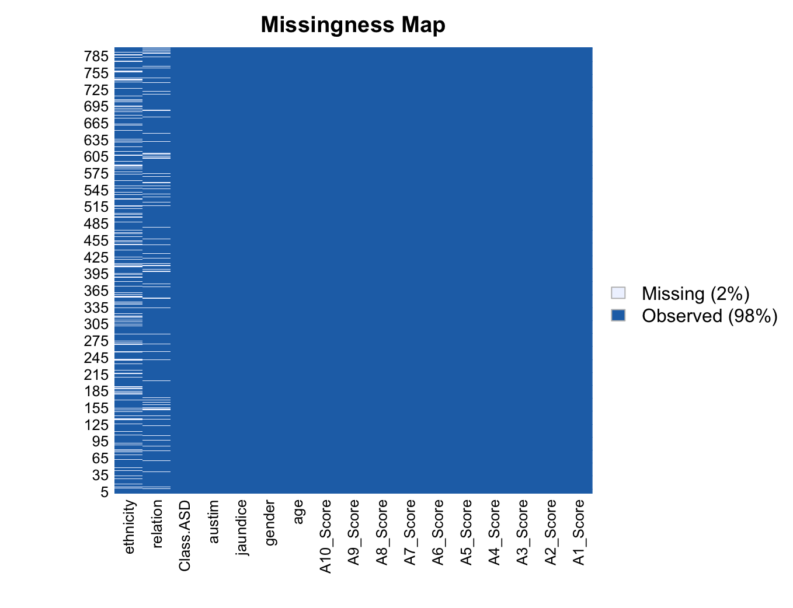
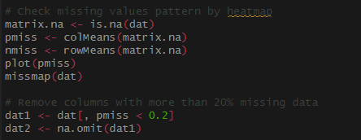
DATA
PRE-PROCESSING :
Missingness Map

Slide 12
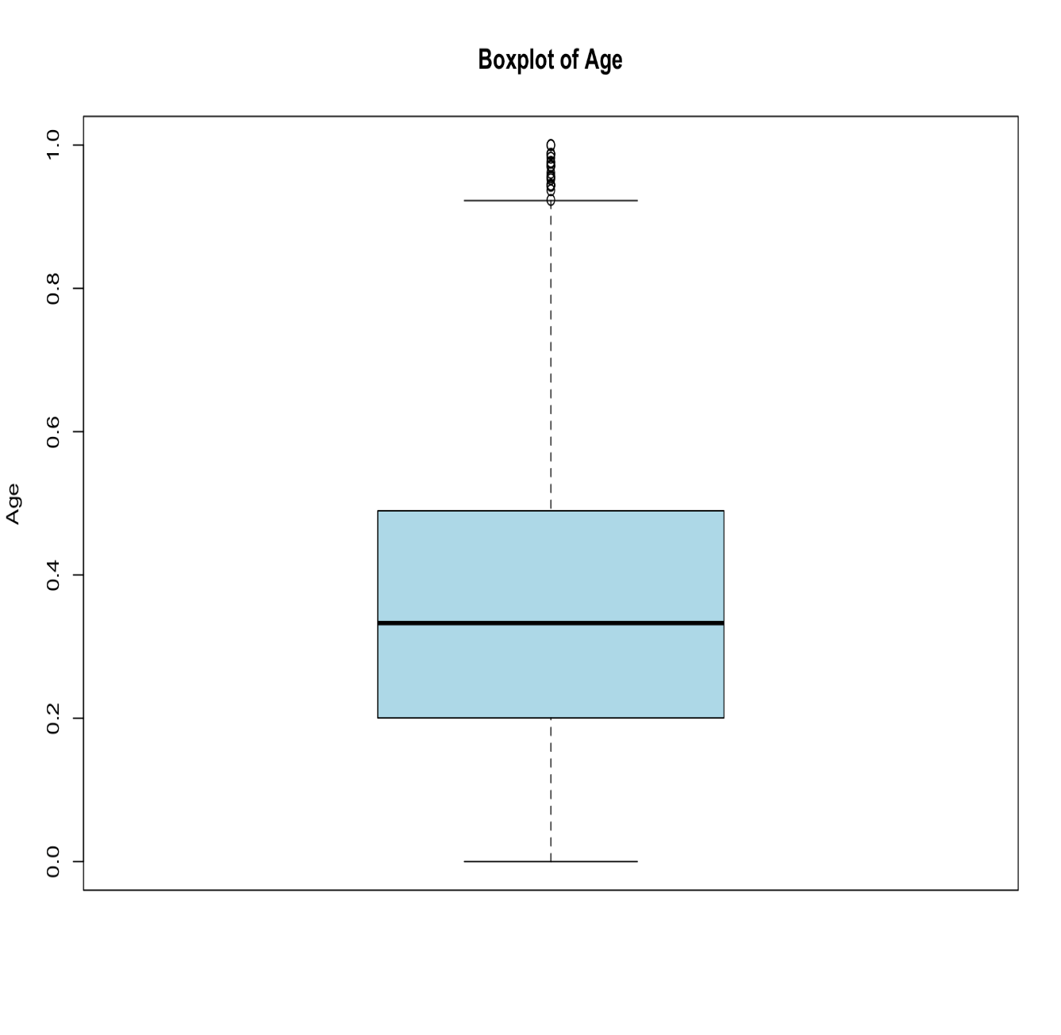
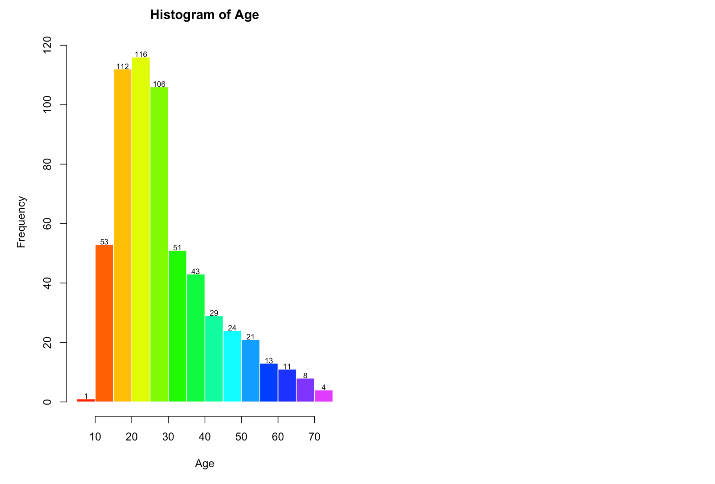
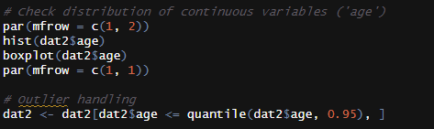
Pre – Processing : Distribution OF Continuous Variable And Handling Outliers

Slide 13
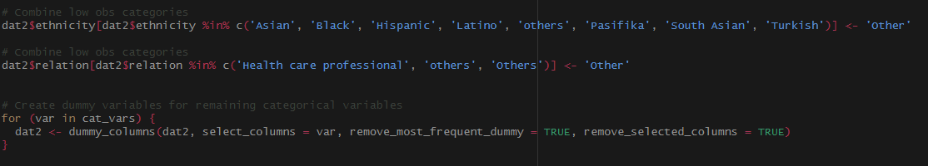
HANDLING CATEGORICAL VARIABLES
This code addresses the handling of categorical variables in the dataset.
It identifies categorical variables ('gender', 'ethnicity', 'jaundice', 'austim', 'relation') and combines categories with low observations into a single category ('Other') to reduce dimensionality and improve model performance.
Dummy variables are created for the remaining categorical variables.

Slide 14
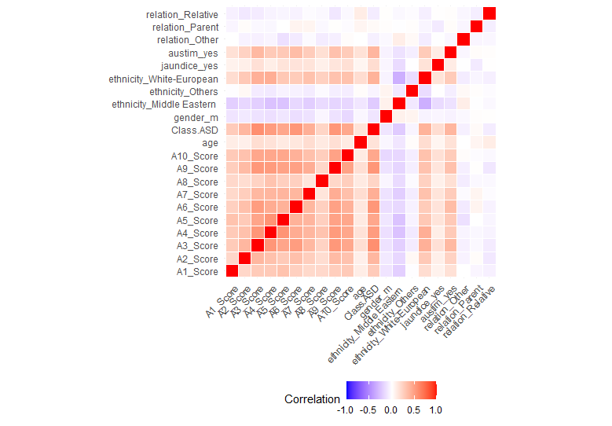
CORRELATION MATRIX

Slide 15
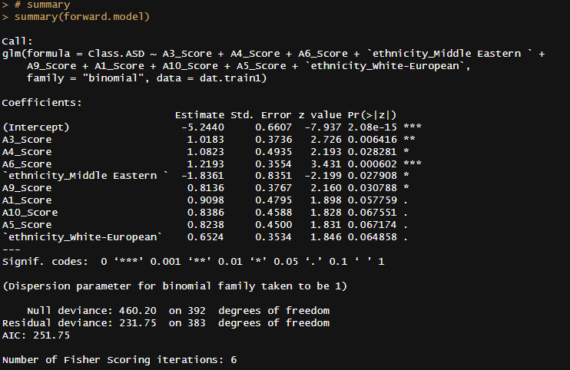
FORWARD MODEL

Slide 16
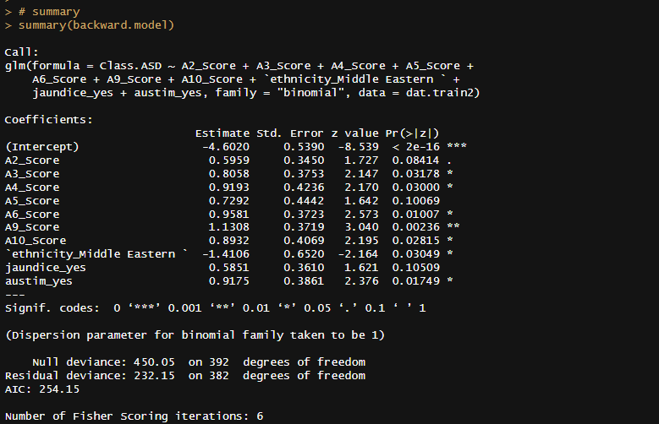
BACKWARD MODEL

Slide 17
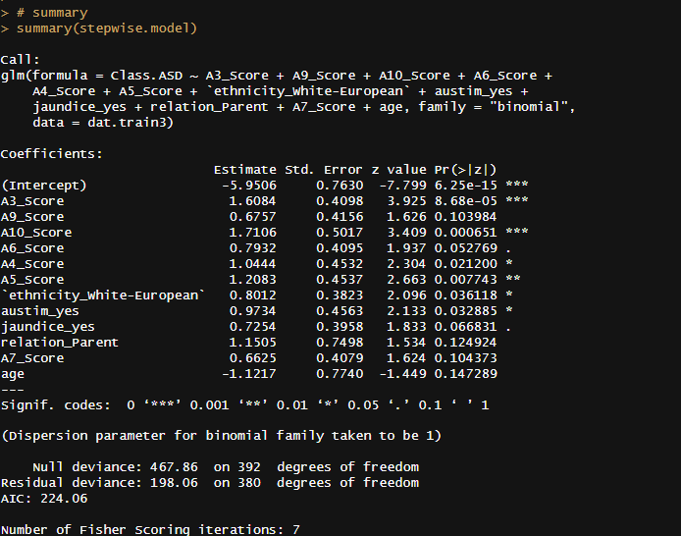
STEPWISE MODEL

Slide 18
Forward Model:
Features: A3_Score, A4_Score, A6_Score, ethnicity_Middle Eastern, A9_Score, A1_Score, A10_Score, A5_Score, ethnicity_White-European
Insights:
High importance is given to A3_Score, A4_Score, and A6_Score, followed by ethnicity_Middle Eastern and A9_Score.
Features like A1_Score and A10_Score have relatively lower importance but still contribute to the model.
Backward Model:
Features: A2_Score, A3_Score, A4_Score, A5_Score, A6_Score, A9_Score, A10_Score, ethnicity_Middle Eastern, jaundice_yes, austim_yes
Insights:
A3_Score and A9_Score appear to be the most influential features, followed by A4_Score and A6_Score.
Ethnicity_Middle Eastern, jaundice_yes, and austim_yes also play significant roles in the model.
Stepwise Model:
Features: A3_Score, A9_Score, A10_Score, A6_Score, A4_Score, A5_Score, ethnicity_White-European, austim_yes, jaundice_yes, relation_Parent, A7_Score, age
Insights:
A3_Score, A10_Score, and A4_Score are the most significant features in the model.
Ethnicity_White-European, austim_yes, and jaundice_yes also contribute to the predictive power of the model.
INSIGHTS
FROM
THE MODELS

Slide 19
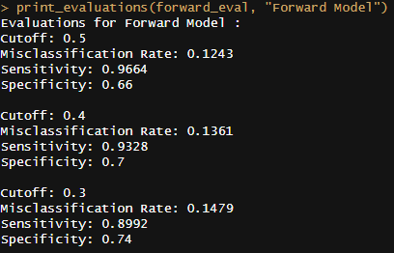
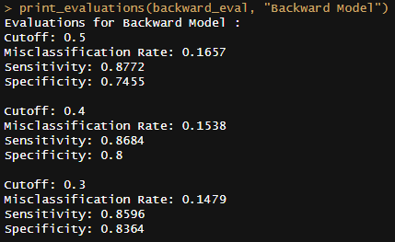
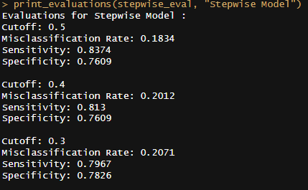
EVALUATING THE MODELS

Slide 20
EVALUATING THE MODELS
The Forward Model prioritizes sensitivity over specificity, resulting in a higher misclassification rate but better identification of positive cases.
The Backward Model achieves a good balance between sensitivity and specificity, especially at lower cutoff values, resulting in lower misclassification rates overall.
The Stepwise Model shows similar trends to the Backward Model but tends to have slightly higher misclassification rates and lower sensitivity at lower cutoff values.

Slide 21
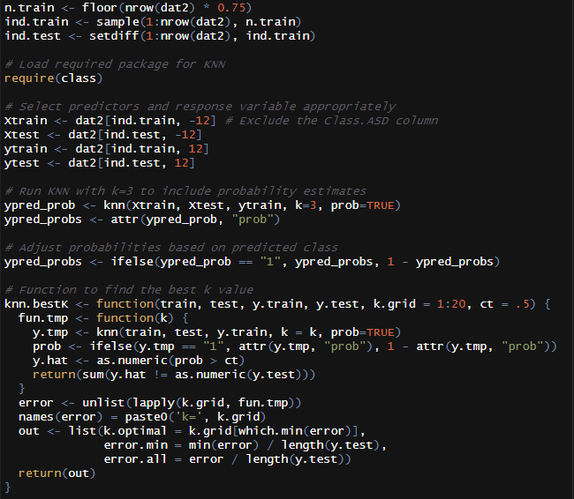
KNN

Slide 22
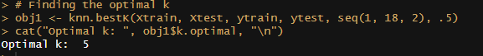
FINDING OPTIMAL K

Slide 23
PERFORMANCE METRICS FOR KNN MODEL
Cutoff | Accuracy | Sensitivity | Specificity | False Positive Rate (FPR) | False Negative Rate (FNR)
0.5 | 0.872 | 0.804 | 0.905 | 0.095 | 0.196
0.4 | 0.872 | 0.804 | 0.905 | 0.095 | 0.196
0.3 | 0.858 | 0.870 | 0.853 | 0.147 | 0.130
Insights:
Accuracy: The model maintains consistent accuracy across different cutoff values, ranging from 85.8% to 87.2%.
Sensitivity: Sensitivity is relatively stable at higher cutoff values but shows a noticeable increase at 0.3, indicating improved detection of true positive cases.
Specificity: Specificity remains high across all cutoff values, indicating a good ability to identify true negative cases.

Slide 24
PERFORMANCE METRICS FOR KNN MODEL
Cutoff | Accuracy | Sensitivity | Specificity | False Positive Rate (FPR) | False Negative Rate (FNR)
0.5 | 0.872 | 0.804 | 0.905 | 0.095 | 0.196
0.4 | 0.872 | 0.804 | 0.905 | 0.095 | 0.196
0.3 | 0.858 | 0.870 | 0.853 | 0.147 | 0.130
False Positive Rate (FPR): FPR stays below 15% for all cutoff values, suggesting a low rate of incorrectly classifying negative cases as positive.
False Negative Rate (FNR): FNR decreases at lower cutoff values, indicating better identification of positive cases while still maintaining acceptable levels at higher cutoffs.
Overall, the KNN model demonstrates consistent performance in classifying ASD cases, with a balanced trade-off between sensitivity and specificity, particularly evident at a cutoff value of 0.3.

Slide 25
CART (CLASSIFICATION AND REGRESSION TREE)
Model Training Parameters:
Algorithm: Classification Tree (rpart)
Target Variable: Class.ASD
Input Variables: All features (excluding Class.ASD)
Parameters Selected:
Minsplit: Minimum number of splits (set to 5)
Xval: Number of Cross-Validations (set to 10)
Cp: Complexity Parameter (set to 0.00001)

Slide 26
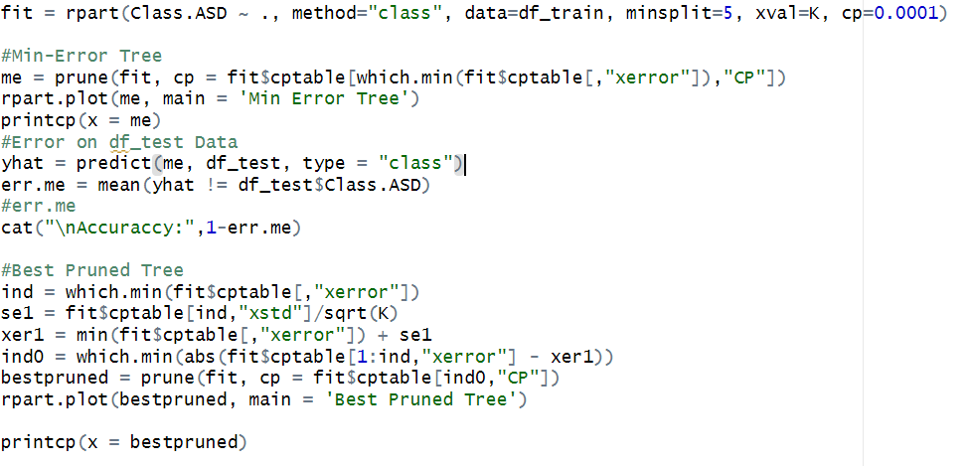
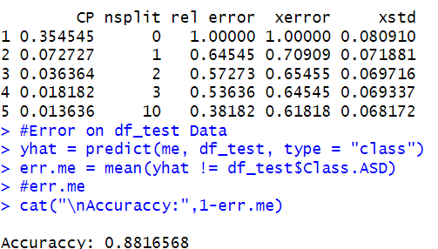
FINDING CP
OUTPUT

Slide 27
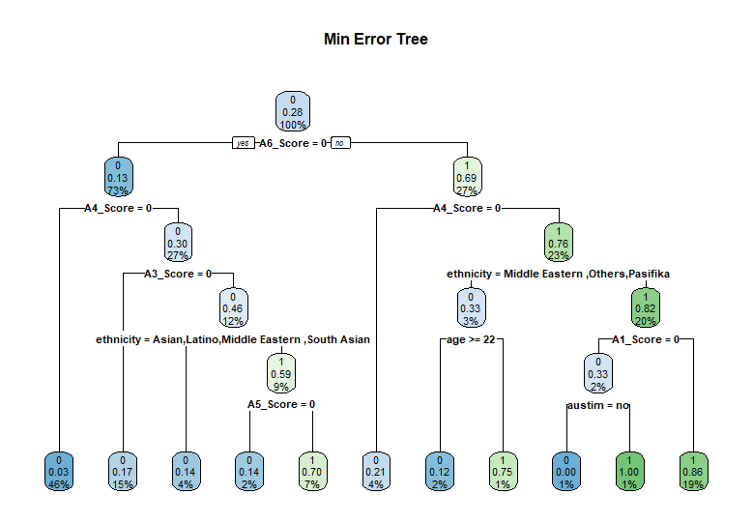
MINIMUM ERROR TREE

Slide 28
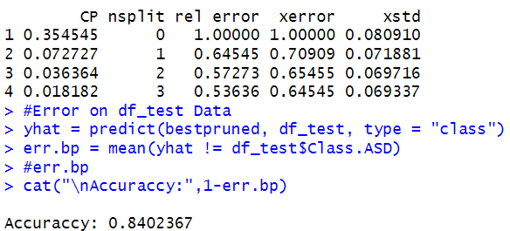
FINDING CP
OUTPUT

Slide 29
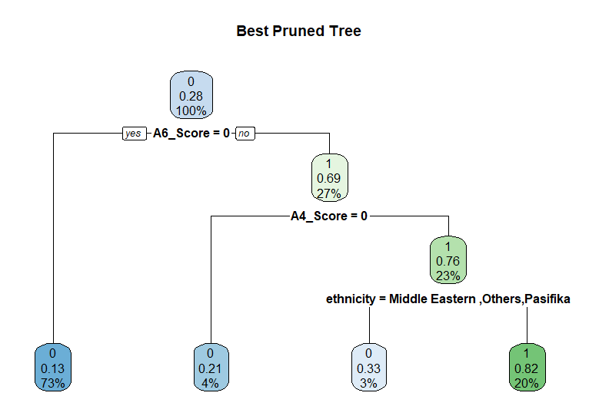
BEST PRUNED TREE

Slide 30
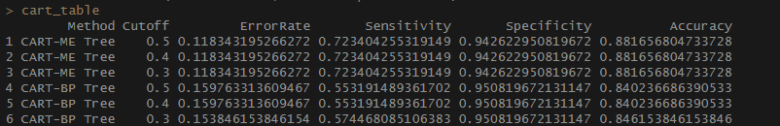
PERFORMANCE METRICS

Slide 31
Comparison with Prior Research:
Alignment with Previous Studies: Findings support Thabtah’s (2017) research on the efficacy of machine learning in ASD screening.
Differences in Model Performance: Slightly higher sensitivity at lower cutoffs in our Backward Model may reflect differences in data sets or feature selection compared to Thabtah’s study.
Need for Diverse Datasets: Discrepancies highlight the importance of using diverse datasets and comprehensive feature engineering in machine learning models for ASD.

Slide 32
Implications and Applications:
Theoretical Support: Results reinforce the hypothesis that machine learning can enhance the accuracy and efficiency of ASD screening.
Practical Integration: The Backward Model could be integrated into diagnostic frameworks to improve decision-making in clinical settings.
Policy Recommendations: Suggests health care systems should consider adopting machine learning-based tools for standard ASD screening protocols.
Real-world Software Implementation: Models could be implemented in diagnostic tools like the ASD Tests app to improve their diagnostic capabilities and accessibility.

Slide 33
Literature Review
Autism spectrum disorder research: knowledge mapping of progress and focus between 2011 and 2022
https://www.ncbi.nlm.nih.gov/pmc/articles/PMC10168184/
A Machine Learning Approach to Predict Autism Spectrum Disorder
https://ieeexplore.ieee.org/document/8679454
Using Machine Learning for Motion Analysis to Early Detect Autism Spectrum Disorder: A Systematic Review
https://link.springer.com/article/10.1007/s40489-024-00435-4
Feature Signature Discovery for Autism Detection: An Automated Machine Learning Based Feature Ranking Framework
https://www.hindawi.com/journals/cin/2023/6330002/

Slide 34
LIMITATIONS
Model Dependency on Data Characteristics
The performance metrics (sensitivity, specificity) of our models may vary significantly with changes in the dataset characteristics, such as demographic variability or symptom presentation, which were not fully explored in this study.
Feature Selection and Engineering
The models could be limited by the initial selection and engineering of features. A deeper exploration into more complex features or alternative data transformations might yield different outcomes.
Sample Size and Diversity
The study may have been limited by the sample size or the lack of diversity within the dataset, which could affect the generalizability of the findings to the broader ASD population.
Evaluation Metrics Limitations
Reliance solely on traditional metrics like misclassification rate, sensitivity, and specificity may not fully capture the practical effectiveness of the ASD screening models in real-world settings.

Slide 35
Future Research
Exploring Additional Data Sources:
Future studies could incorporate data from more diverse populations to see how model performance varies across different demographic and clinical profiles.
Advanced Feature Engineering
Investigating more sophisticated machine learning techniques and feature engineering, including deep learning approaches that might uncover more nuanced patterns in the data.
Longitudinal Data Analysis:
Utilizing longitudinal datasets to assess how well early screening predictions hold up over time as children develop and more behavioral data becomes available.
Implementation and Testing in Clinical Settings
Conducting pilot studies to test the feasibility and effectiveness of these models in real clinical settings, assessing not just their predictive accuracy but also their usability and impact on diagnostic processes.

Slide 36
Learnings From The Analysis
Model Sensitivity and Specificity: The sensitivity and specificity vary by model type (Forward, Backward, Stepwise) and cutoff settings, with the Backward Model often showing lower misclassification rates.
Optimal KNN Parameter: The optimal number of neighbors for the KNN model is 5, suggesting a balance that minimizes both overfitting and underfitting.
Importance of Cutoff Selection: The choice of cutoff thresholds significantly impacts the trade-off between sensitivity and specificity, which is crucial for tailoring the model to specific clinical needs.

